Slide 1
Pediatric Pain PRN Course
Welcome
Notes:
Materials: Provide participant guide to be provided to participants at least 1 week in advance.
Flip chart or whiteboard and Markers
Room setup in tables o f 4 or 6-8 depending on number of participants
Display slide as participants walk in
THIS SESSION IS 1 minute/participant
© 2017 Manworren & Lurie Children’s Hospital
All rights reserved. Version 2019

Slide 2
Disclosures
[Include CEU
Statement and instructions, such as
In order to complete this session you must attend the entire session and complete an evaluation form at the end of the session. }
[Include disclosures from all faculty and facilitators of this educational content, such as
“No other planners, presenters, faculty, authors and content reviewers of this educational activity have indicated they have conflicts of interest.”]
Edit to include actual event CE & disclosures
Notes:
Welcome & Introductions: Introduce facilitator and faculty if necessary
READ: Slide (CE statement and Disclosures)
© 2017 Manworren & Lurie Children’s Hospital
All rights reserved. Version 2019

Slide 3
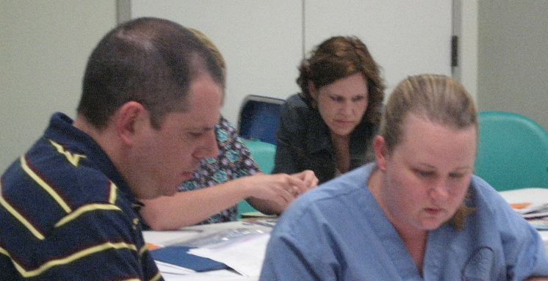
Implementing the Pediatric PRN Role
PRN learning objectives
Engage patients, families, leaders, and interdisciplinary healthcare teams to identify opportunities and develop action plans to improve sensitivity to children’s pain and clinical pain care provided.
Assess your unit, specialty, organization, and community for opportunities to successfully educate patients/families and/or the interdisciplinary health care team, conduct evidence-based practice, research, and/or performance improvement projects that will facilitate optimal pain management and systemize quality pain care.
Analyze your potential for success in the PRN role based on your qualifications and evaluation of your institution’s leadership commitment, interdisciplinary teamwork, and resources to address staff/organization challenges and barriers to optimal pain care.
Evaluate how your goals for the PRN role align with the outlined PRN responsibilities and the institutions care priorities.
A PRN interfaces with healthcare team members, patients, and families as a resource, change agent, and leader to disseminate information, facilitate optimal pain management, and systemize quality evidence-based pain care. This curriculum focuses on preparing nurses and networks of interdisciplinary champions to promote a healthcare culture that is sensitive to children’s pain
Notes:
READ:
A PRN has traditionally been a Pain Resource Nurse, aRegistered Nurse who interfaces with healthcare team members, patients, and families as a resource, change agent, and leader to disseminate information, facilitate optimal pain management, and systemize quality pain care.
This course has expanded the PRN role to include Pain Resource Networks, interdisciplinary teams to champion sensitivity to pediatric pain and evidence-based practice among healthcare team regardless of professional discipline.
Each content section of this curriculum includes live flipped learning activities and participant guides.
The participant guides should be read before the learning activity.
© 2017 Manworren & Lurie Children’s Hospital
All rights reserved. Version 2019

Slide 4
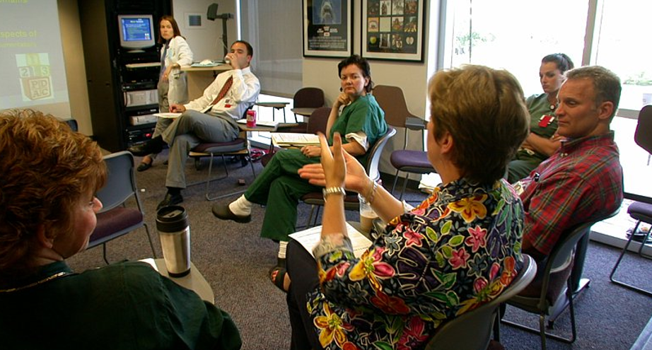
Curriculum Goals
Break down institutional barriers
Empower pediatric pain resource nurses (PRNs) to champion a healthcare culture sensitive to children’s pain
Notes:
READ: This curriculum is geared to preventing, assessing, treating, and understanding pain in children.
It’s goals are to:
Break down institutional barriers , and
Empower pediatric pain resource nurses (PRNs) to champion a healthcare culture sensitive to children’s pain
Introductions
READ: Please introduce yourself.
Provide your name, role, department, and
one thing you can do to improve pediatric pain care by the end of this week, and
one thing you can do to improve pediatric pain care by the end of this year (or 12 months from now).
Flip to next slide as participants start
© 2017 Manworren & Lurie Children’s Hospital
All rights reserved. Version 2019

Slide 5

Take a minute to reflect…
Is your leadership committed to your active involvement in this effort? Are you?
Who are key members of your collaborative interdisciplinary team who effectively communicate vertically and horizontally?
Where can you focus your first effort for the quickest win and biggest reward?
Do you have the resources you need to secure success?
Notes:
Write participants goals for the end of week,
and end of year on flipchart or whiteboard.
[Limit to 1minute/participant]
Participants should be providing names, roles, departments,
one thing you can do to improve pediatric pain care by the end of this week,
one thing you can do to improve pediatric pain care by the end of this year (or 12 months from now).
© 2017 Manworren & Lurie Children’s Hospital
All rights reserved. Version 2019

Slide 6
What to Expect
Interactive Presentations
Case Studies
Pain Rounds
Working Lunches
Special Topics
Coaching & Networking
Breakout Sessions
Notes:
READ: The gap from knowledge to implementation in clinical practice is 17 years. You can close this gap and start to improve pediatric pain care this week. The flipped learning model we are using will provide you with both knowledge & opportunities to refine the skills you will use to implement evidence-based pain practice. These activities reinforce the key messages of our PRN curriculum.
Interactive Presentations –You’ll have a chance to discuss, apply, and test your learning.
Work Groups –You’ll work through the steps of developing a pain improvement project unique to your patients needs & decide how to implement the PRN role in your organization.
Coaching & Networking – You will network with peers and receive individualized coaching .
Breakout Sessions –Using the ”see one, do one, teach one” technique, you will experience pain management interventions, and confidently use and disseminate these interventions this week!
© 2017 Manworren & Lurie Children’s Hospital
All rights reserved. Version 2019

Slide 7
Workshop Agenda
Edit to include actual event schedule…
Day 1
Day 2
Overview & resources
Analgesics
Lunch: Breaking barriers
Data to inform change
Break-outs: Biobehavioral
Wrap-up
Case studies
Assessment of pain
Acute pain
Implement PRN role
Pain rounds
Fact check and fix
Procedural pain
Lunch: Leading change
3 Special topics
Post-test, evaluation
Notes:
Case Studies – provide a deep dive into common pediatric cases, where you’ll synthesize what you learned and confidently endorse new approaches to assessing and managing pediatric pain.
Pain Rounds – are an opportunity to accompany experts in motion rounding on actual patients. You’ll learn there is more than one right way to treat pain.
Special Topics –may not be applicable to everyone, like pain in critically ill children and neonates. These are provided content for those PRNs who care for these vulnerable patients with pain.
READ: Here is the 2-day intensive workshop schedule.
Provide instructions to organize the days, such as “Rank the biobehavioral breakout preferences.”
ASK: Any questions?
READ: Let’s get started!
[Session ends at 1 minute/participant}
© 2017 Manworren & Lurie Children’s Hospital
All rights reserved. Version 2019

